Slide 1
Introduction of the Graph, Graph Analysis, and Graph Neural Network
April Workshop Serial 1

Slide 2
Table of Contents
Success of DL and AI
Some Obstacles of AI Adoption
What is graph, and Why Need It
Concepts and Terms for Takeaway
Graph Neural Network (GNN)
DGL in GNN
Limitations
Wrap up & Q&A

Slide 3
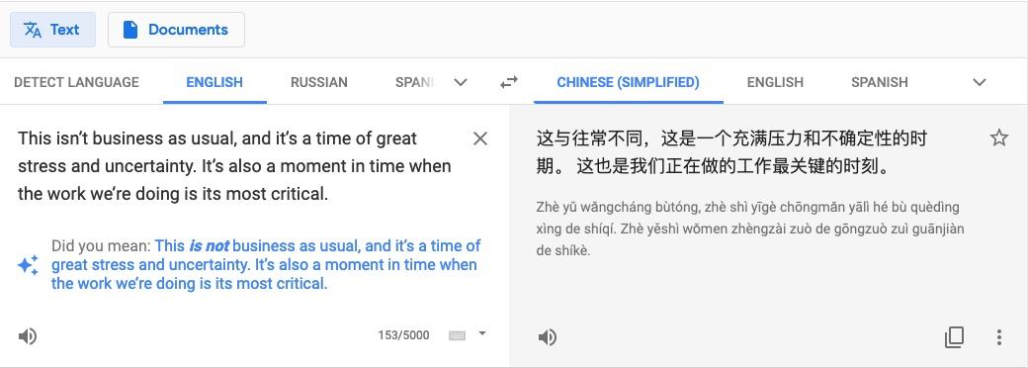
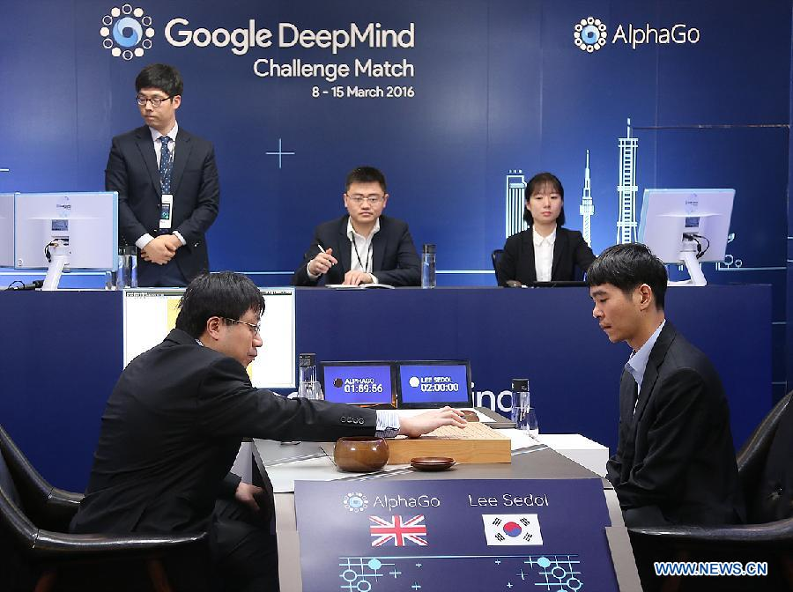
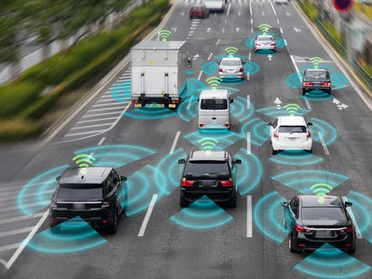

Booming of AI
We are in the AI area

Slide 4
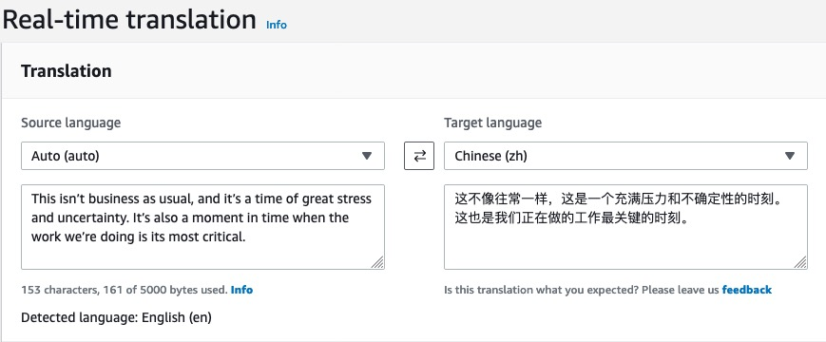

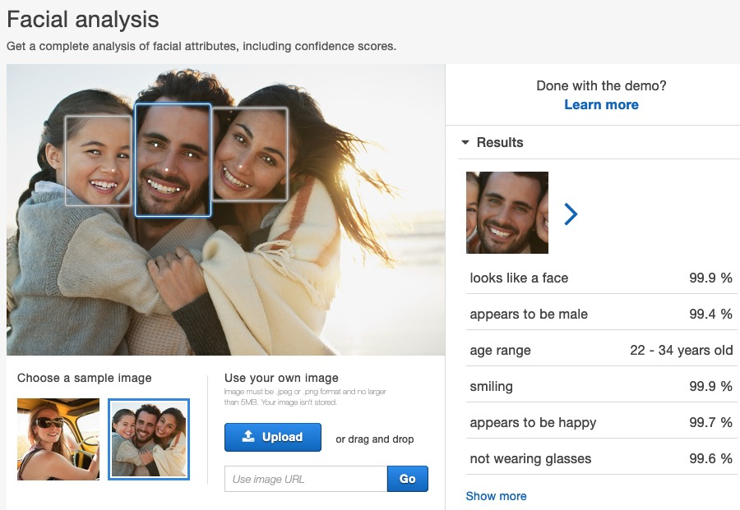
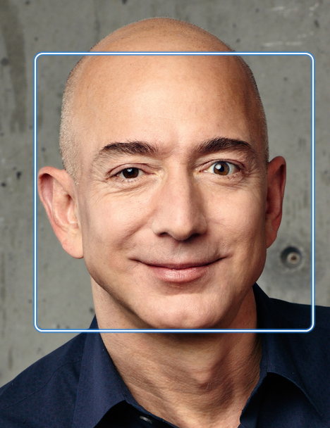
Booming of AI in Amazon
We has our own arsenal

Slide 5

Obstacles of AI Adoption
Business Scenarios
Experts
Data, Data, Data – Labeled Data!
Have we been fully leveraging the existing data,
especially the rich relational information?

Slide 6
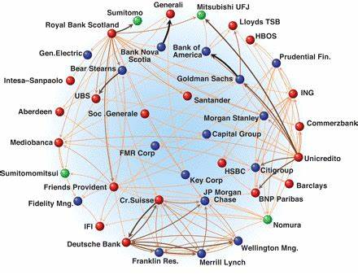
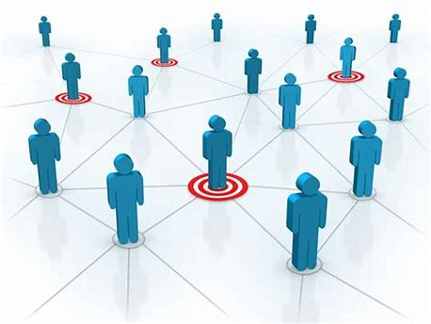
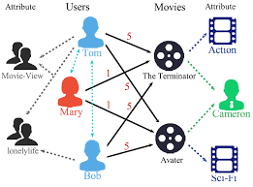
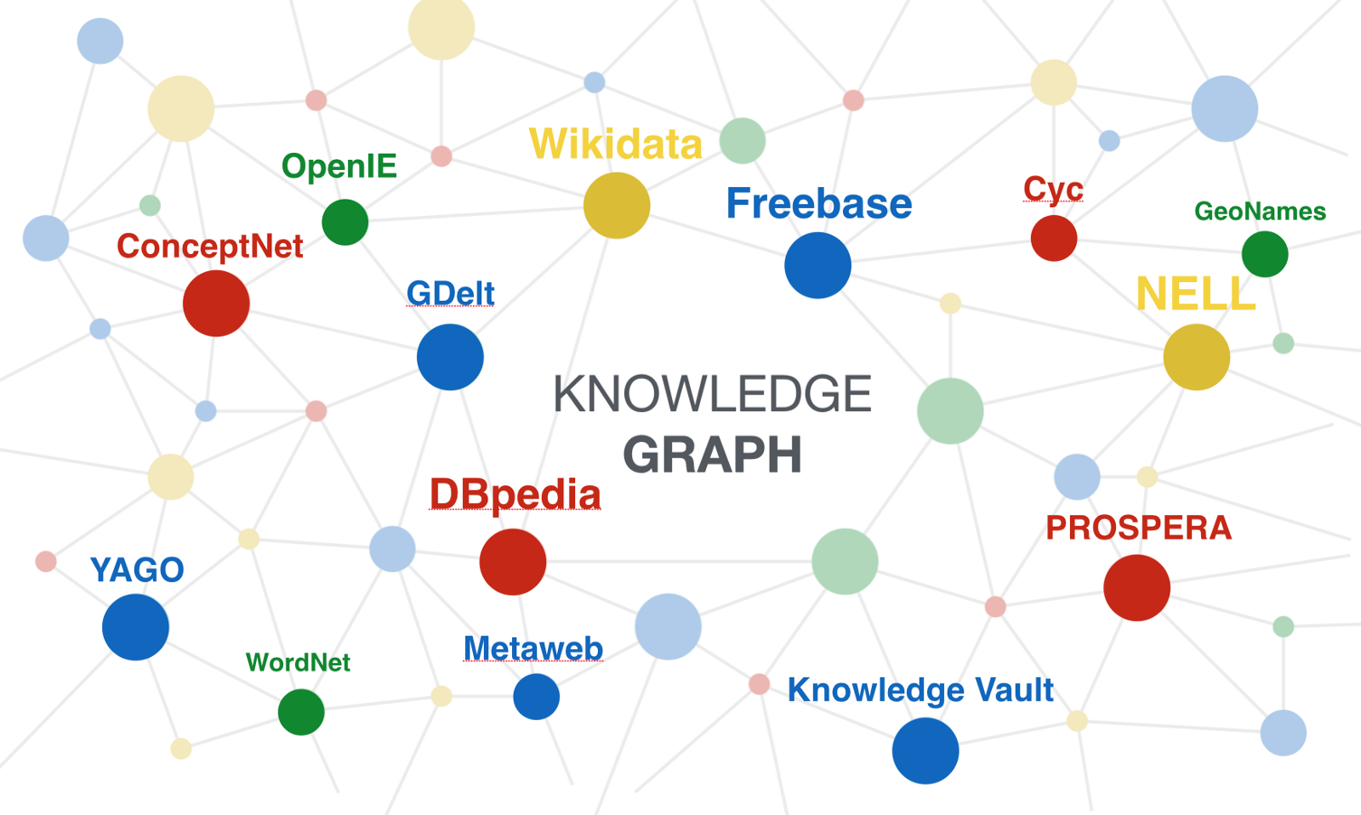
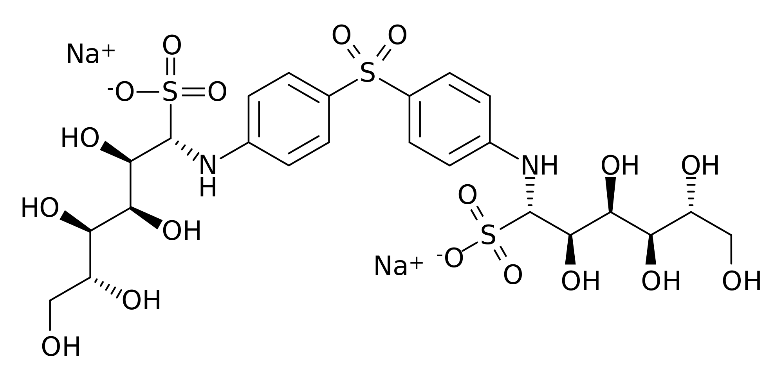
What is Graph
Graph is the language of complex interactions
Social network
Collaborative knowledge graph
Financial transactions network
Chemical molecule
Knowledge graph
Notes:
Graph data is everywhere

Slide 7
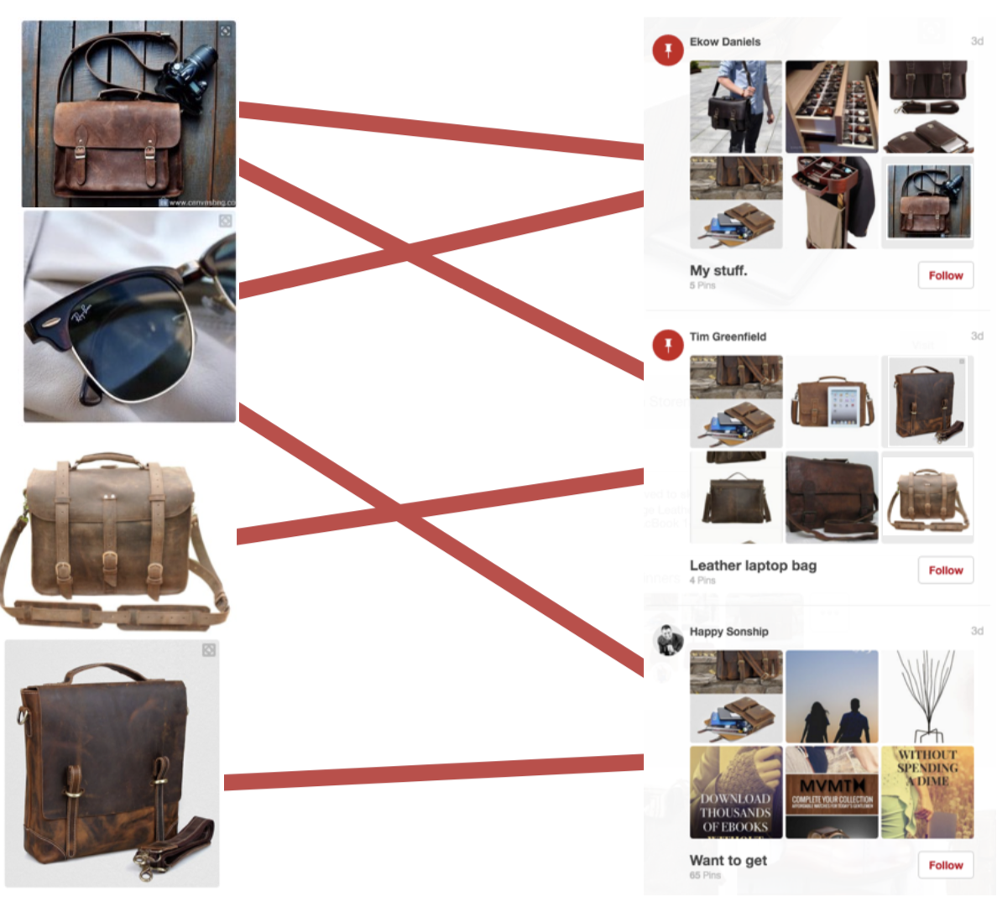
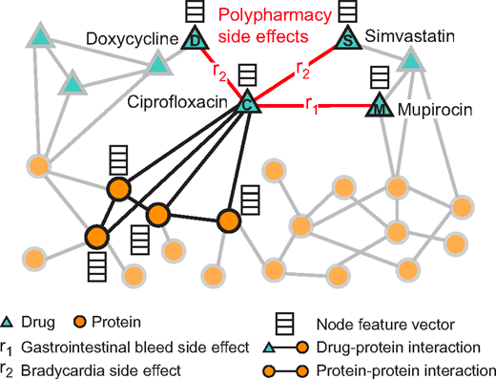
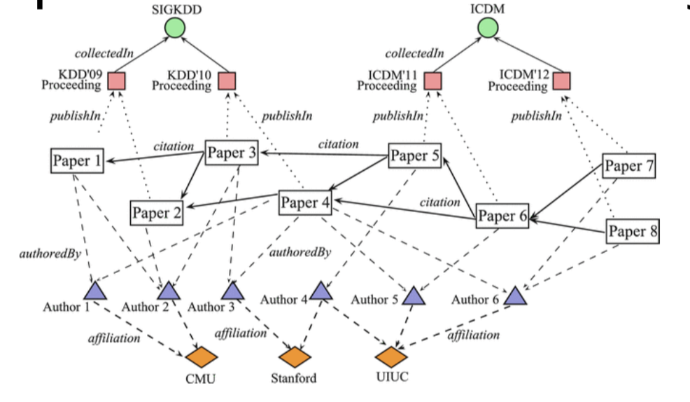
Why do we need Graphs
Complex domains have rich relational structure, which can be represented as a relational graph
Web, Social, Bio, Health, Science, and Mediciine
By explicitly modeling relationships we achieve better performance.
Data availability
Existing data have rich relational information
Some existing systems have implicitly used graph
Recommender System
Fraud detection
Precision marketing
Knowledge graph
Informatics

Slide 8
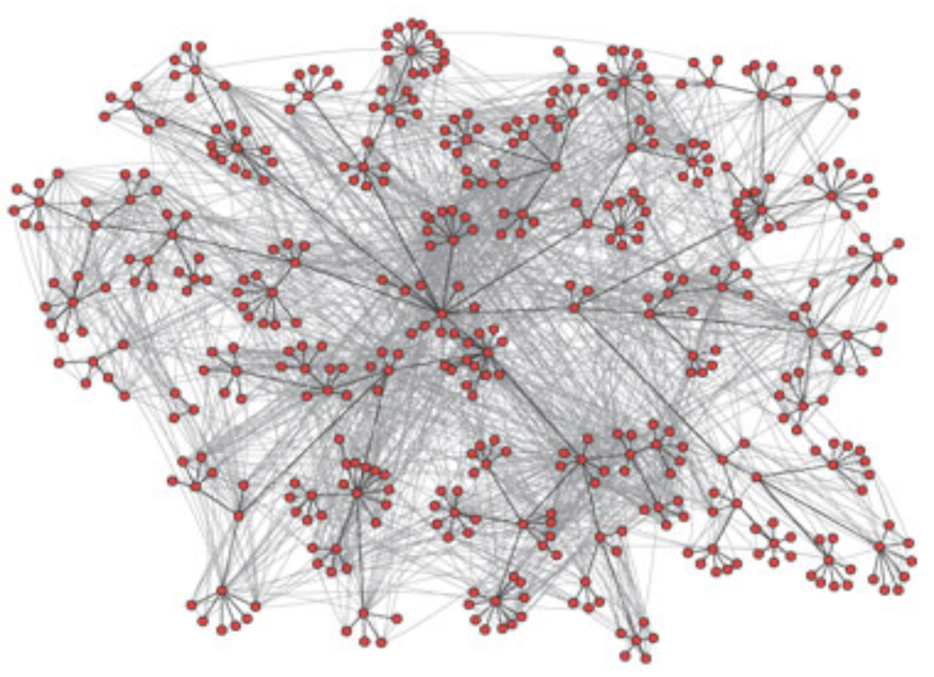
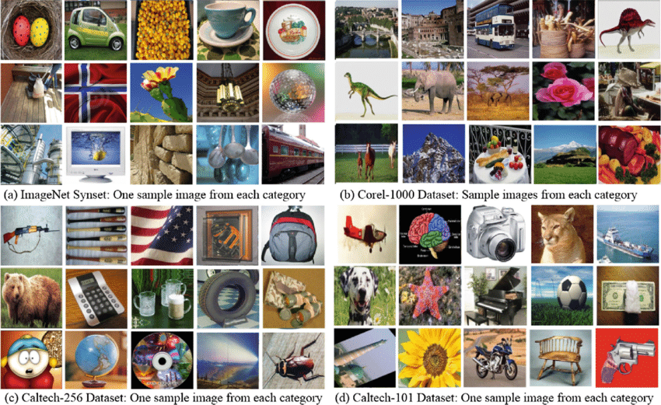
Concepts and terms
Graph vs Image
此“图”非彼“图”
Notes:
Graph vs Image
Node vs Vertex
Edge vs Link
Undirected vs Directed
Homogeneous Graph vs Heterogeneous Graph
Structure information vs Feature information

Slide 9
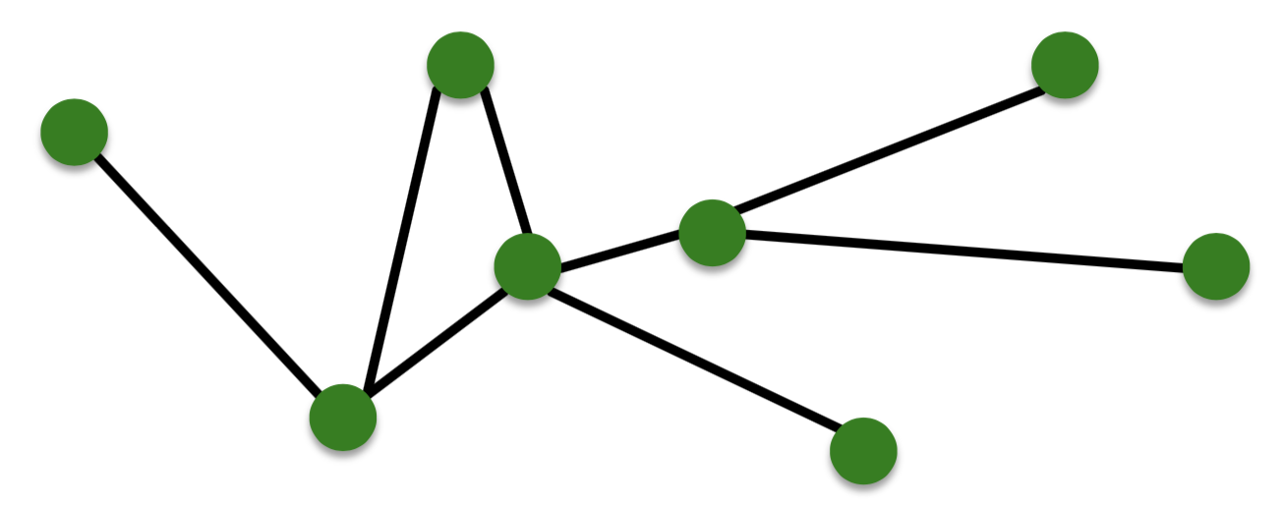
Concepts and terms
N
Node vs Vertex
Edge vs Link
G(N, E)
E
Notes:
Graph vs Image
Node vs Vertex
Edge vs Link
Undirected vs Directed
Homogeneous Graph vs Heterogeneous Graph
Structure information vs Feature information

Slide 10
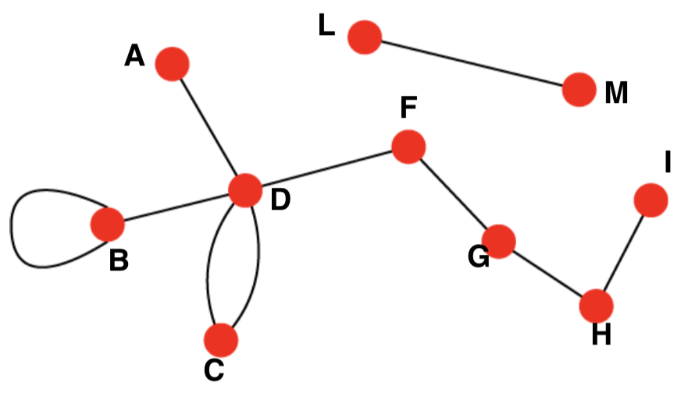
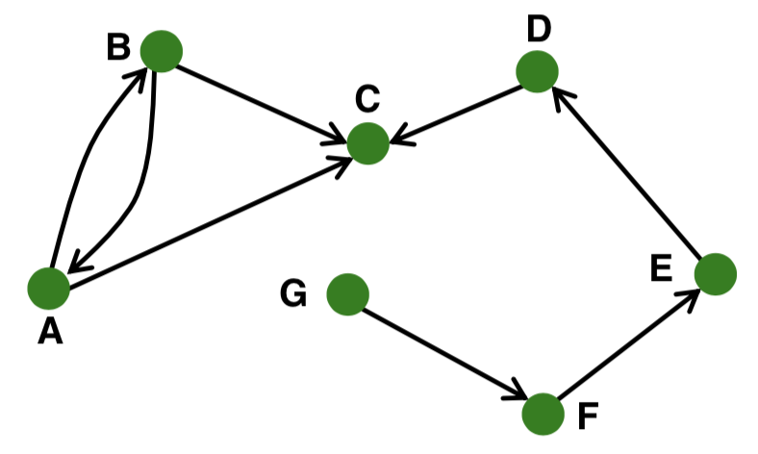
Concepts and terms
Undirected vs Directed
Notes:
Graph vs Image
Node vs Vertex
Edge vs Link
Undirected vs Directed
Homogeneous Graph vs Heterogeneous Graph
Structure information vs Feature information

Slide 11
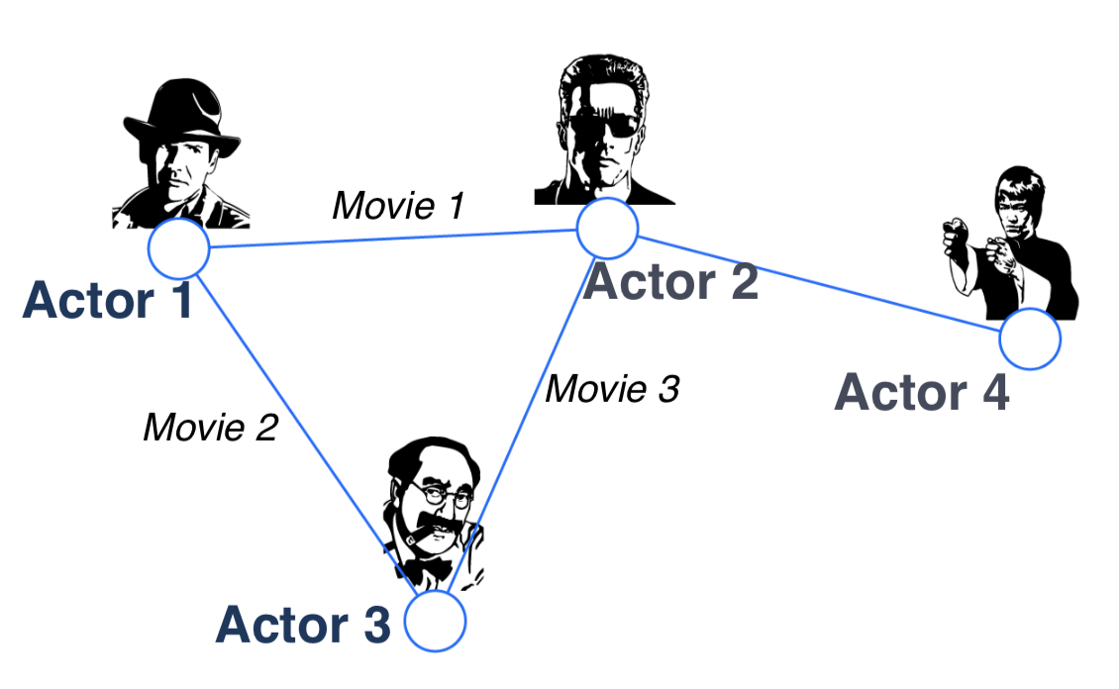
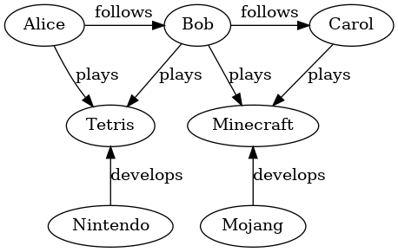
Concepts and terms
Homogeneous vs Heterogeneous
Notes:
Graph vs Image
Node vs Vertex
Edge vs Link
Undirected vs Directed
Homogeneous Graph vs Heterogeneous Graph
Structure information vs Feature information

Slide 12
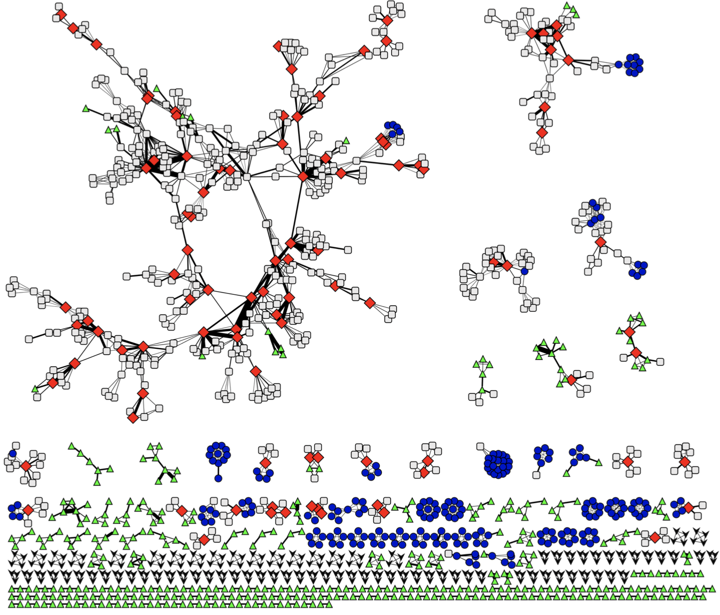
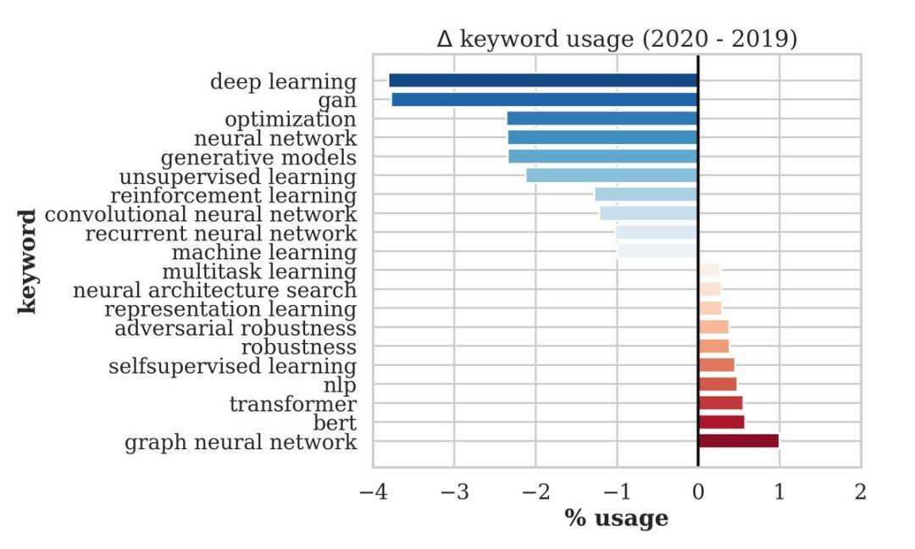
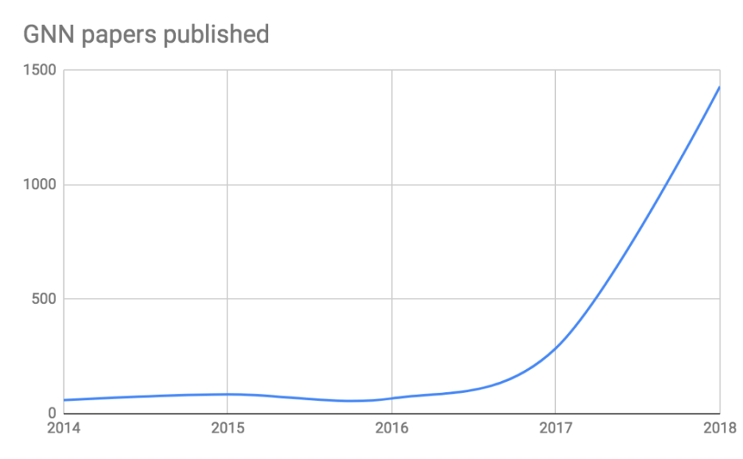
Graph Neural Network (GNN)
Graph analysis and learning has a long history
DL(NN) + Graph => GNN
A family of (deep) neural networks that learn node, edge, and graph features

Slide 13
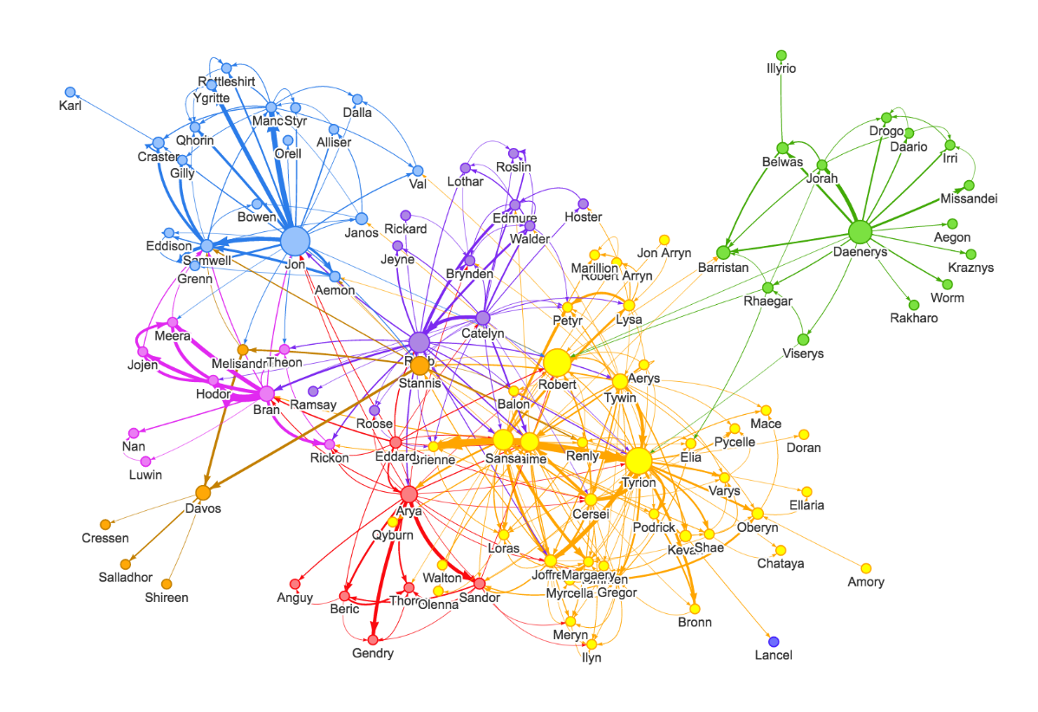

Why GNN
DL Models CNN/RNN
Traditional Graph Learning
Manual
Manual
Supervision
Node/Edge
Feature Extraction
Structure Feature Extraction
Classification/ Regression Models
DL Models CNN/RNN
GNN
MLP
End 2 End
Deep Graph Learning

Slide 14


How does GNN work
Normal
GNN
Classifier
Fraudster

Slide 15
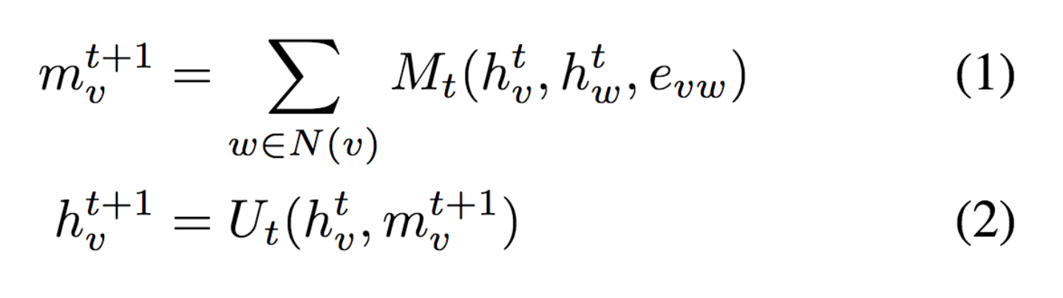
How does GNN work
Reduce function
Message function
Update function

Slide 16
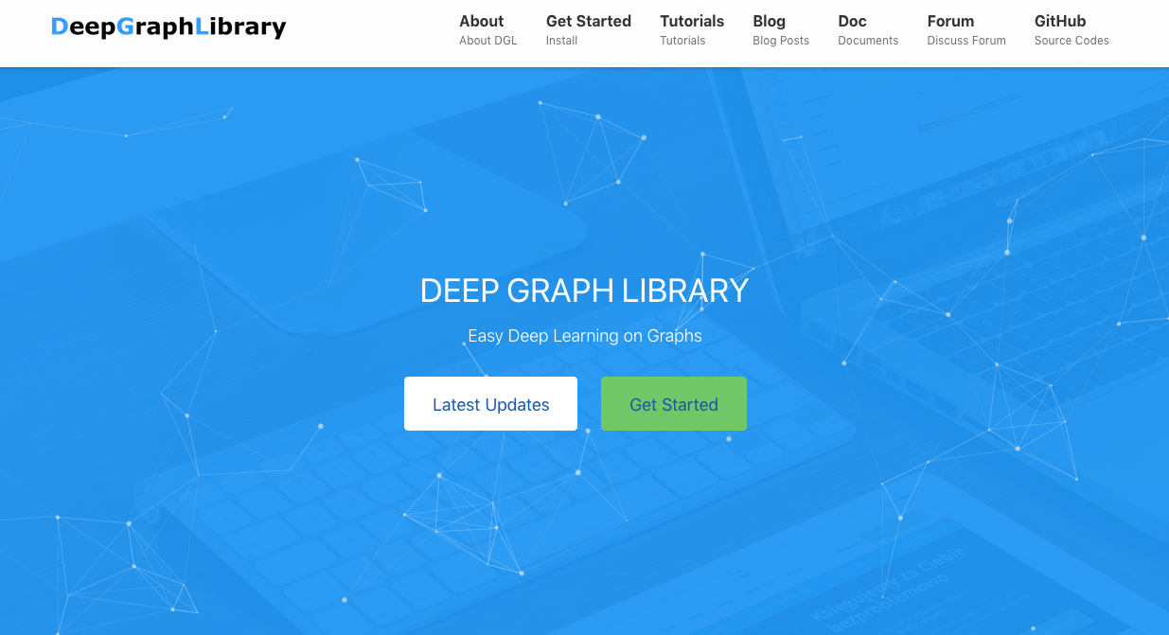
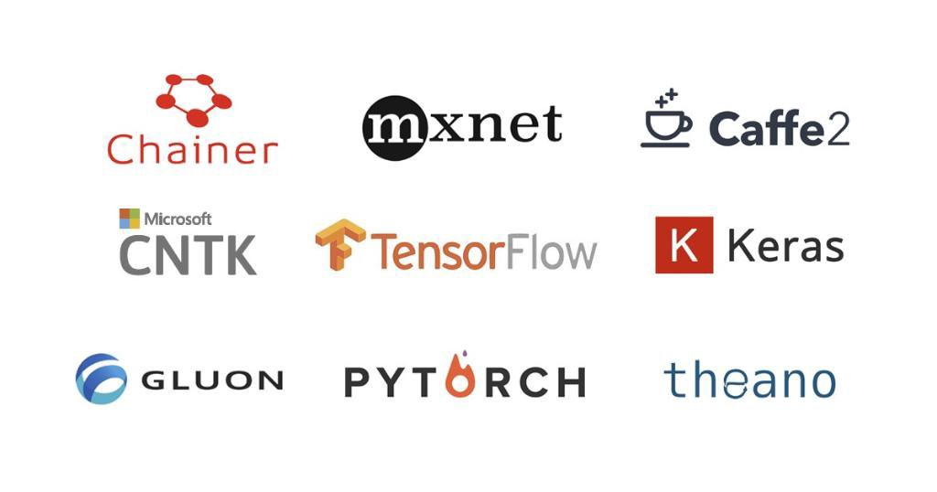
DGL in GNN
DGL make using GNN much easier and ready to engage customers
Industrial adoption of AI needs good ML and AI frameworks
Hard to implement GNN with TensorFlow/PyTorch/MXNet
(Our implementation) caused OOM … which is the reason for the lack of results on Pubmed.
-- from the authors of Graph Attention Network [ICLR’18]

Slide 17
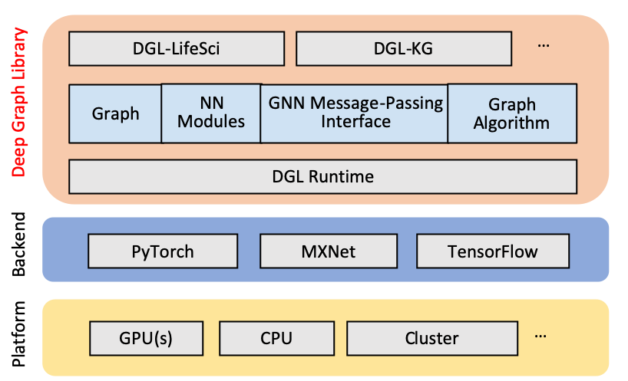
DGL in GNN

Slide 18
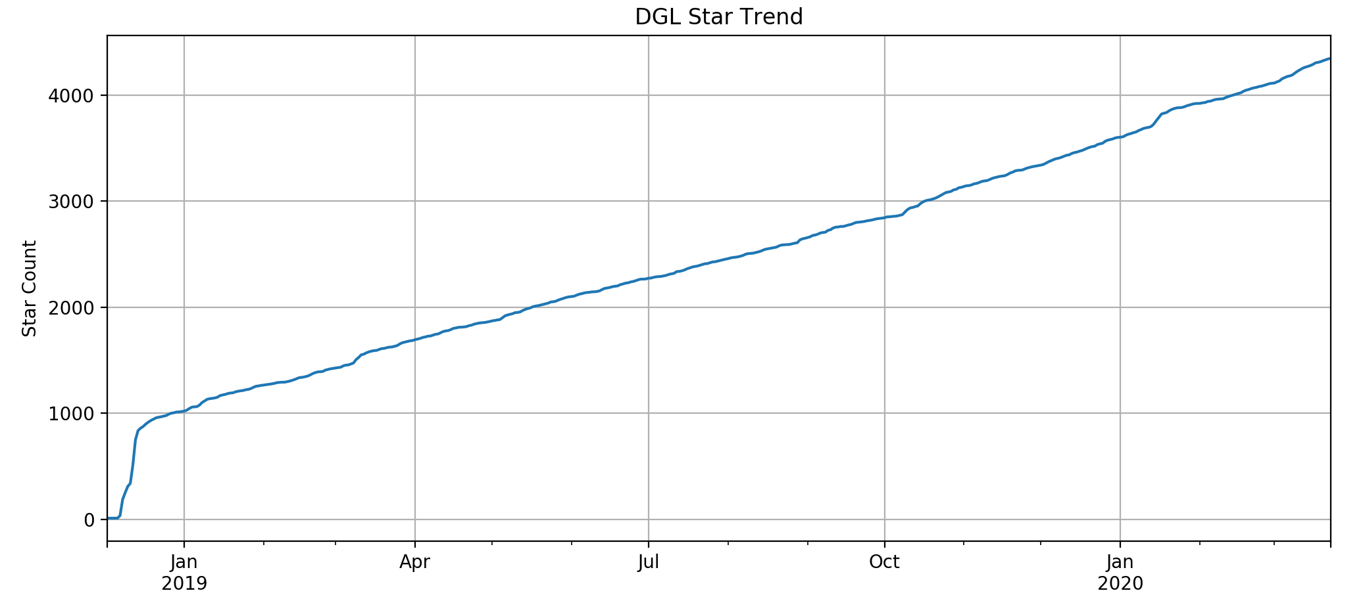
DGL in GNN
V0.5 – May 2020
V0.3 release
19x Speed up
Distributed Training
V0.4.2 release
TensorFlow support
MXNet Modules
V0.1 release
Open Source release
V0.4 release
Heterograph support
DGL Knowledge Graph
V0.2 release
Multiple GPU support
Large graph sampling

Slide 19
Limitations
Graph brings information, but noise as well
GNN research is in a fast lane, but is still developing
GNN has proven its values in some scenarios, but need more cases

Slide 20
Wrap Up
Complex interactions are everywhere
Graph capture these relational information
Graph Neural Network is the new wave of AI
DGL make using GNN much easier and ready to engage customers
GNN needs more solid business cases

